Slide 1
Thursday, September 15, 2016
Write In Your Agenda:
Write In Your Monitoring Log:
CW:
Finish Plotting the Evidence
Picturing Life on Pangaea
HW:
None.
Response to Warm-Up:
Describe how evidence helps support or deny scientists' theories and claims.
You will need:
Pencil
Plotting the Evidence Sheets

Slide 2
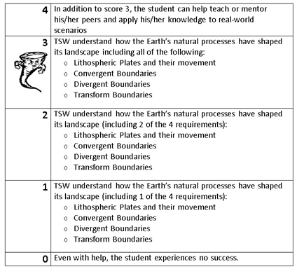
Learning Goal and Scale
TSW understand how the Earth’s natural processes have shaped its landscape (including Lithospheric Plates and their movement, Convergent, Divergent, and Transform boundary landforms).

Slide 3
https://www.youtube.com/watch?v=KCSJNBMOjJs

